Slide 1

From Zero to Cloud with Apache Cassandra™
NOVEMBER 25th 2019
Cedrick Lunven - Developer Advocate DataStax

Slide 2



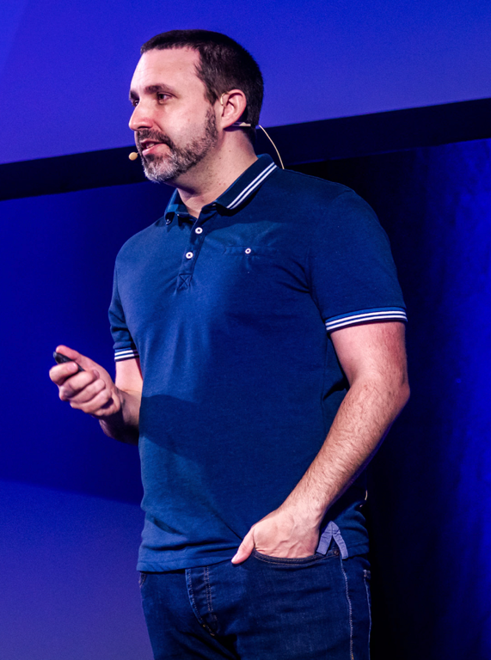

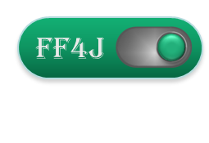








About me
https://github.com/clun
@clunven
https://fr.linkedin.com/in/clunven

Slide 3
Agenda
0
Bootstraping
1
Understanding Apache Cassandra™ Use Cases
2
Data Modelling with Apache Cassandra™
3
Application Development
4
What’s NEXT ?

Slide 4
Bootstrapping
Meetup @Stockholm

Slide 5
Set-up Apollo
Exercise
Apollo Instance
Database
Studio
Notes:
This is an instructor-lead Exercise
Since it takes a few minutes for
Open two tabs in a browser: one for DSA and the other for Constellation
Following the exercise in DSA, walk participants through how to build a database

Slide 6
Apollo.datastax.com
Notes:
We can even specify a consistency level of ALL,
<click> (CL=ALL appears)
Which means we will read all replicas
<click> (third read line appears)
(pause to let people absorb)

Slide 7
Let’s things initializing…

Slide 8


Simplify application development
Public IP Endpoint
CLIENT
Local Desktop
Client VPC
Notes:
Traditionally, Cassandra-based solutions require that the client be on the same network as the server nodes to connect via the driver.
However, Apollo provides a secure connection to the database over the open internet without the need to configure VPC peering or any complex networking setup.
Using mutually trusted and verified communication channels (mTLS), you can continue to work within your integrated development environment (IDE)—all you have to do is provide the credentials to your drivers, bulk loader, and cqlsh utility.
With Apollo’s secure remote database connectivity you can easily port existing applications into the cloud.

Slide 9
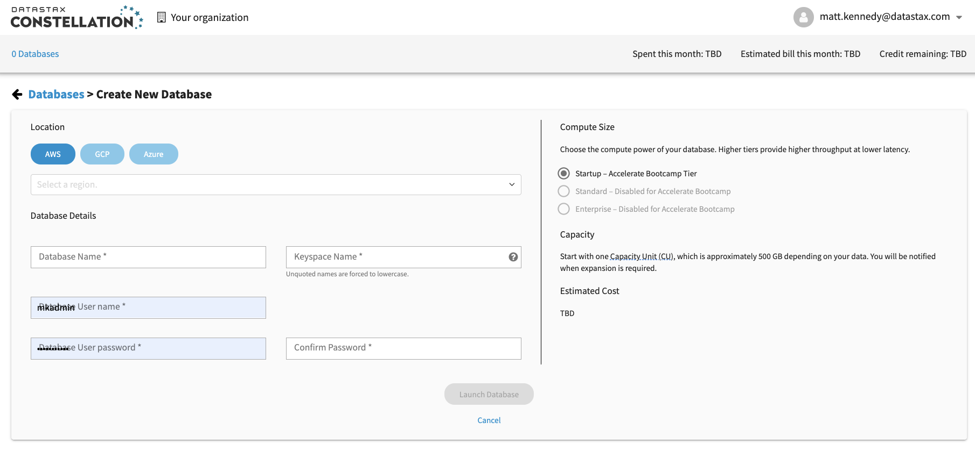
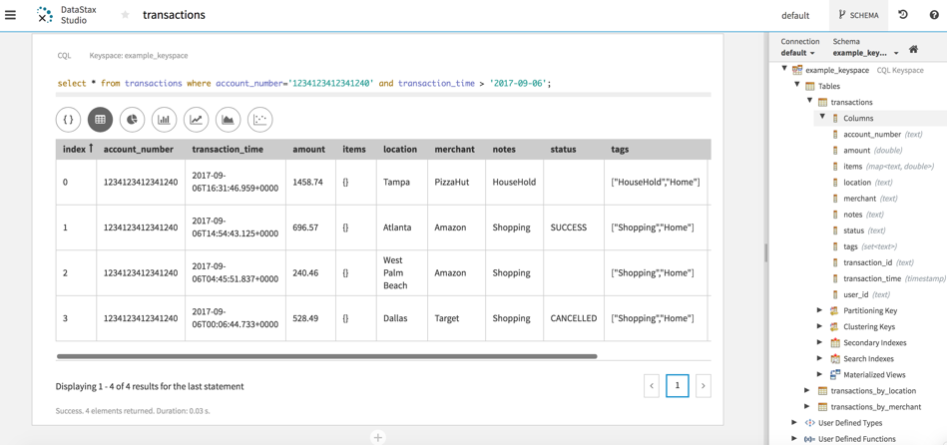
Simplify application development
1-BUTTON CLICK FROM CLOUD CONSOLE TO WEB-HOSTED INTEGRATED DEVELOPER ENVIRONMENT (DATASTAX STUDIO)
Notes:
Apollo provides a frictionless developer experience.
A smart client side download that lets developers easily load data from on-premises to Apollo clusters and begin application development with their favorite language.
Developers can invoke our DataStax Studio tool from within the cloud console and immediately be taken to a web-hosted version of the product that lets them immediately start coding.

Slide 10
Agenda
0
Bootstraping
1
Understanding Apache Cassandra™ Use Cases
2
Data Modelling with Apache Cassandra™
3
Application Development
4
What’s NEXT ?

Slide 11
Understanding Apache Cassandra™ Use Cases
Meetup @Stockholm

Slide 12

Apache Cassandra™ = Distributed NoSQL Database
NODE
1 Installation = 1 NODE
Capacity: ± 1TB
Throughput: 3000 Tx/sec/core
NODE
NODE
DataCenter | Ring
NODE
NODE
Communication:
Gossiping
NODE
NODE

Slide 13
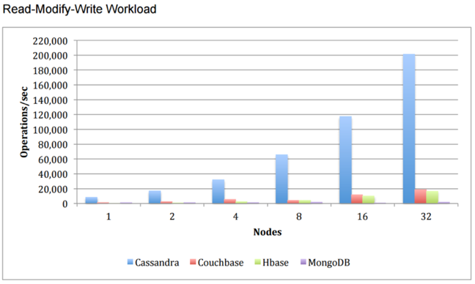
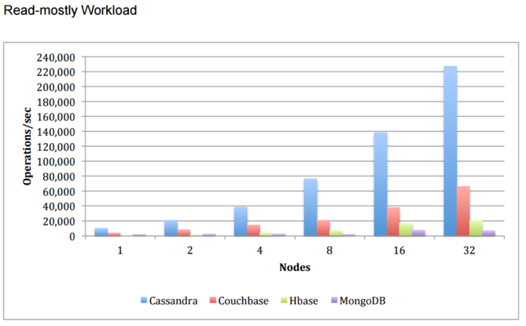
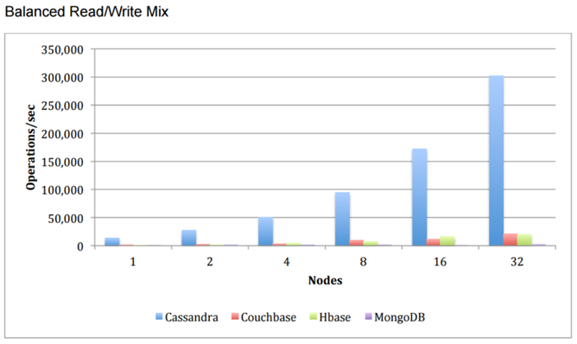
Linear Scalability
Need More Capacity ? ➔ Add new nodes
Need more Throughput ? ➔ Add new nodes

Slide 14
Data is Distributed
Country
City
Habitant
USA
New York
8.000.000
USA
Los Angeles
4.000.000
FR
Paris
2.230.000
DE
Berlin
3.350.000
UK
London
9.200.000
AU
Sydney
4.900.000
DE
Nuremberg
500.000
CA
Toronto
6.200.000
CA
Montreal
4.200.000
FR
Toulouse
1.100.000
JP
Tokyo
37.430.000
IN
Mumbai
20.200.000
Partition Key

Slide 15





Data is Distributed
A-E
F-G
X-Z
H-K
U-W
Range
Q-T
L-P

Slide 16
Data is Evenly-distributed
CO | City | Habitant
AU | Sydney | 4.900.000
CA | Toronto | 6.200.000
CA | Montreal | 4.200.000
DE | Berlin | 3.350.000
DE | Nuremberg | 500.000
CO | City | Habitant
59 | Sydney | 4.900.000
12 | Toronto | 6.200.000
12 | Montreal | 4.200.000
45 | Berlin | 3.350.000
45 | Nuremberg | 500.000
Partitionner
Hashing Function
Partition Key
Tokens
A-E

Slide 17
How the Ring Works
0
Coordinator node
59 (data)
83
17
67
33
50
Notes:
•Cassandra stores data using a logical ring structure.
•Any node can talk to any other node,
•but the ring is how Cassandra organizes data
•I’ll explain…
•<click>
Since all nodes are peers,
•ANY node can service the request
•There is no concept of a manager node.
•The node that handles the request, is called the coordinator node.
•The coordinator can be different for each request
•In this request, we are using the top-left node as the coordinator.
<click>
•Imagine we want to store some data in the cluster
•Cassandra stores data in units called partitions
•Each partition has a unique partition number
•called a partition token
<click>
•In this example the partition token is 59
•When we want to store data, we have 2 questions:
•Which node do we talk to first, and
•Which node will actually store the data
•<click>
•The coordinator determines which node will store the data.
•How does the coordinator do that? Great question!
•<click>
•Each node takes a slice of the token range.
•In this example, the token range is 0-99 (it’s really much larger).
•This means the top node stores all partitions whose tokens fall in the range of 88-0.
•The next node, clockwise, stores partitions with values falling in the range of 1-13, and so on.
•<click>
•Since the bottom node is responsible for partition tokens from 51 to 63 (purple range), and the data’s partition token is 59, the coordinator forwards the data to the purple node.
•<click>
Note: ANY node can act as the coordinator. All nodes are aware of the ring token value distribution, and all nodes (should be configured to) use the same partitioner. Thus any node can determine which nodes store which data. There is no leader node in Apache Cassandra(TM).

Slide 18
How the Ring Works
0
Coordinator node
83
17
59 (data)
59 (data)
67
33
Replica node
50
Notes:
•Cassandra stores data using a logical ring structure.
•Any node can talk to any other node,
•but the ring is how Cassandra organizes data
•I’ll explain…
•<click>
Since all nodes are peers,
•ANY node can service the request
•There is no concept of a manager node.
•The node that handles the request, is called the coordinator node.
•The coordinator can be different for each request
•In this request, we are using the top-left node as the coordinator.
<click>
•Imagine we want to store some data in the cluster
•Cassandra stores data in units called partitions
•Each partition has a unique partition number
•called a partition token
<click>
•In this example the partition token is 59
•When we want to store data, we have 2 questions:
•Which node do we talk to first, and
•Which node will actually store the data
•<click>
•The coordinator determines which node will store the data.
•How does the coordinator do that? Great question!
•<click>
•Each node takes a slice of the token range.
•In this example, the token range is 0-99 (it’s really much larger).
•This means the top node stores all partitions whose tokens fall in the range of 88-0.
•The next node, clockwise, stores partitions with values falling in the range of 1-13, and so on.
•<click>
•Since the bottom node is responsible for partition tokens from 51 to 63 (purple range), and the data’s partition token is 59, the coordinator forwards the data to the orange node.
•<click>

Slide 19
How the Ring Works
0
83
17
67
33
59 (data)
Replica node
50
Notes:
•Cassandra stores data using a logical ring structure.
•Any node can talk to any other node,
•but the ring is how Cassandra organizes data
•I’ll explain…
•<click>
Since all nodes are peers,
•ANY node can service the request
•There is no concept of a manager node.
•The node that handles the request, is called the coordinator node.
•The coordinator can be different for each request
•In this request, we are using the top-left node as the coordinator.
<click>
•Imagine we want to store some data in the cluster
•Cassandra stores data in units called partitions
•Each partition has a unique partition number
•called a partition token
•In this example the partition token is 59
•When we want to store data, we have 2 questions:
•Which node do we talk to first, and
•Which node will actually store the data
•<click>
•The coordinator determines which node will store the data.
•How does the coordinator do that? Great question!
•<click>
•Each node takes a slice of the token range.
•In this example, the token range is 0-99 (it’s really much larger).
•This means the top node stores all partitions whose tokens fall in the range of 88-0.
•The next node, clockwise, stores partitions with values falling in the range of 1-13, and so on.
•<click>
•Since the bottom node is responsible for partition tokens from 51 to 63 (purple range), and the data’s partition token is 59, the coordinator forwards the data to the purple node.
•<click>
Note: ANY node can act as the coordinator. All nodes are aware of the ring token value distribution, and all nodes (should be configured to) use the same partitioner. Thus any node can determine which nodes store which data. There is no leader node in Apache Cassandra(TM).

Slide 20
Replication within the Ring
0
59 (data)
83
17
RF = 2
67
33
50
Notes:
•<click> (RF=2 appears)
•Let's increase the replication factor to 2
•<click> (ring colors double)
•This doubles the range that each node is responsible for.
•For example, node 67 becomes responsible for
•the orange range
•and the purple range
•<click> (data appears)
•Again our request to write partition with token 59 arrives.
•But this time the coordinator sends it to two nodes.
•<click> (data moves)
•<click> (data fades)

Slide 21
Replication within the Ring
0
83
17
59 (data)
59 (data)
RF = 2
67
33
50
Notes:
•<click> (RF=2 appears)
•Let's increase the replication factor to 2
•<click> (ring colors double)
•This doubles the range that each node is responsible for.
•For example, node 67 becomes responsible for
•the orange range
•and the purple range
•<click> (data appears)
•Again our request to write partition with token 59 arrives.
•But this time the coordinator sends it to two nodes.
•<click> (data moves)
•<click> (data fades)

Slide 22
Replication within the Ring
0
83
17
59 (data)
RF = 2
67
33
59 (data)
50
Notes:
•<click> (RF=2 appears)
•Let's increase the replication factor to 2
•<click> (ring colors double)
•This doubles the range that each node is responsible for.
•For example, node 67 becomes responsible for
•the orange range
•and the purple range
•<click> (data appears)
•Again our request to write partition with token 59 arrives.
•But this time the coordinator sends it to two nodes.
•<click> (data moves)
•<click> (data fades)
•Let's increase the replication factor to 3

Slide 23
Replication within the Ring
0
59 (data)
83
17
RF = 3
67
33
50
Notes:
<click> (RF=3 appears)
•This means that each node is responsible for 3 ranges
•<click> (3 ranges appear)
•Once again, the data arrives at the coordinator
•Where will the coordinator send the data this time?
•<click> (data moves)
•We see the data replicated to all three nodes
•<click> (data fades)
•So, in a nutshell, that's how replication works

Slide 24
Replication within the Ring
0
83
17
59 (data)
59 (data)
RF = 3
67
33
50
Notes:
<click> (RF=3 appears)
•This means that each node is responsible for 3 ranges
•<click> (3 ranges appear)
•Once again, the data arrives at the coordinator
•Where will the coordinator send the data this time?
•<click> (data moves)
•We see the data replicated to all three nodes
•<click> (data fades)
•So, in a nutshell, that's how replication works

Slide 25
Replication within the Ring
0
59 (data)
83
17
59 (data)
RF = 3
67
33
59 (data)
50
Notes:
<click> (RF=3 appears)
•This means that each node is responsible for 3 ranges
•<click> (3 ranges appear)
•Once again, the data arrives at the coordinator
•Where will the coordinator send the data this time?
•<click> (data moves)
•We see the data replicated to all three nodes
•<click> (data fades)
•Essentially, this is how replication works

Slide 26

Node Failure
0
83
17
59 (data)
59 (data)
RF = 3
67
33
50
Notes:
Consider what happens when a node (or a few nodes) fail due to unforeseen circumstances.
Here we have one failing node
Notice this also happens to be replica nodee for our partition 59 that we wrote to the cluster.
<click> (request for 59 appears)
Let's say we want to read partition 59
Note: any node can coordinate
<click> (request to get data appears)
Notice the data is still available from the two remaining nodes 67 and 0
So we can service the request from this node
<click> (data moves)

Slide 27
Node Failure
0
59 (data)
83
17
Hint
59 (data)
RF = 3
67
33
59 (data)
50
Notes:
Hinted Handoff is one of the data consistency mechanisms built into Cassandra.
When a node in the cluster goes down, the remaining nodes will save mutations (writes) for this node locally as hint
<click>
The hinted handoff makes sure that the write gets to all nodes that hold a replica

Slide 28

Node Failure
0
59 (data)
83
17
Hint
59 (data)
RF = 3
67
33
59 (data)
50
Notes:
Hinted Handoff is one of the data consistency mechanisms built into Cassandra.
When a node in the cluster goes down, the remaining nodes will save mutations (writes) for this node locally as hint
The hinted handoff makes sure that the write gets to all nodes that hold a replica

Slide 29
Node Failure – Recovered!
0
59 (data)
83
17
59 (data)
RF = 3
67
33
59 (data)
50
Notes:
Note that hinted handoffs will only be stored if the consistency level for the request can be met.
We’ll talk more on consistency here in a bit

Slide 30
CAP Theorem
Consistency
Availability
Cassandra is an AP system (by default)
Partition Tolerance
Notes:
CAP stands for consistency, availability, and partition tolerance.
Consistency: The database replicas agree on the current state of the data.
Availability: The cluster can return a response.
Partition Tolerance: During a network partition (failure), the system still service requests.
CAP Theorem: During a failure, you can only guarantee 2 of the 3.
The CAP theorem applies to distributed systems when there is a failure
When there is no failure, you get all three.
During failure, Cassandra defaults to Availability and Partition tolerance
In other words, it continues to run
But you can change the default on a per-query basis
This is called tunable consistency
In a big data scenario where there are multiple machines acting as your database, you have to make a choice here.
There is no way around it.
If you are serving users around the planet,
unless you are willing to pay the time penalty for every request,
there is no physical way to keep two geographically separated clusters in sync 100% of the time.

Slide 31

Consistency Levels
Coordinator node
Client
RF = 3
CL = ONE
Notes:
Consistency level is different than replication factor.
On a read, consistency level is how many replicas you read
Each replica has a timestamp.
The most recent replica wins
In this example, we have a replication factor of 3.
So when we write, we write 3 replicas of the data.
<click>
Now let's say we want to read from this cluster with a consistency level of 1.
In this case, we only need to read from a single node to resolve the data.
<click>
Now, we can change the consistency level to quorum,
<click> (CL=QUORUM appears)

Slide 32
Consistency Levels
Coordinator node
Client
RF = 3
CL = QUORUM
Notes:
Which means we want to read a majority of the replicas.
Since the replication factor is 3, quorum implies reading 2 replicas
<click> (second read line appears)
Note: if the replicas ever disagree, the coordinator returns the data with the most recent timestamp
<click> (CL clears)

Slide 33
Consistency Levels
Coordinator node
Client
RF = 3
CL = ALL
Notes:
We can even specify a consistency level of ALL,
<click> (CL=ALL appears)
Which means we will read all replicas
<click> (third read line appears)
(pause to let people absorb)

Slide 34
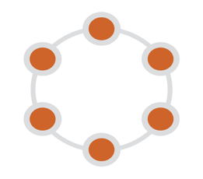




Data Distributed Everywhere
On-premise
GEOGRAPHICALLY
HYBRID- MULTI CLOUD

Slide 35
Understanding Use Cases
Event Streaming
Internet of Things
Log Analytics
Heavy Writes
Any TimeSeries
S
High Throughput
Caching
High Volume
Heavy Reads
Market Data
Banking
Prices
A
No Data Loss
Mission Critical
Availability
Track and Trace
Reponsive System
Customer Apps
Enterprise Data Layer
R
Any CRUD
Realtime
Applications
API Layer
Global Company
D
Geograhically
Retailers
Distributed
Hybrid Cloud
Deployments
MultiCloud

Slide 36
Agenda
0
Bootstraping
1
Understanding Apache Cassandra™ Use Cases
2
Data Modelling with Apache Cassandra™
3
Application Development
4
What’s NEXT ?

Slide 37
Data Modelling with Apache Cassandra™
Meetup @Stockholm

Slide 38
Cassandra Structure - Partition
Keyspace
columns
Table
Tabular data model, with one twist
Keyspaces contain tables
Tables are organized in rows and columns
Groups of related rows called partitions are stored together on the same node (or nodes)
Each row contains a partition key
One or more columns that are hashed to determine which node(s) store that data
- | - | - | -
x | - | - | -
 | - | - | -
partitions
y | - | - | -
 | - | - | -
 | - | - | -
z | - | - | -
rows
Partition key
Notes:
Keyspaces are like databases in the relational world
Keyspaces contain tables

Slide 39
Example Data – Users organized by city
Keyspace users
Table users_by_city
City | Last Name | First Name | Address | Email
Phoenix | Hellson | Kevin | 23 Jackson St. | kevin@gmail.com
 | Lastfall | Norda | 3 Stone St | dino@gmail.com
 | Smith | Jana | 3 Stone St | wilm@gmail.com
Seattle | Franklin | George | 2 Star St | gjet@gmail.com
 | Jackson | Jane | 2 Star St | jane@gmail.com
 | Jasons | Judy | 2 StarSt | judy@gmail.com
partitions
rows
Partition key column
Clustering columns
Data columns
Notes:
If you understand how Cassandra handles data, data modeling becomes intuitive
A partition is the basic unit that Cassandra retrieves
It’s like a subset of a table – or a set of (one or more) rows
All rows in the partition have the same partition key
<CLICK>
In this case, the partition key is “Bedrock”
<CLICK>
Cassandra needs to hash the partition key to figure out which node holds the partition
<CLICK>
So, for example, “Bedrock” might hash to a value of 42
<CLICK>
Which we see is the partition number
The partition can have clustering columns
These columns determine the order of the rows within the partition
The partition key, along with the clustering columns, make up the primary key for the row
Each separate row must have a unique primary key, otherwise, the rows will collide causing an upsert
<CLICK>
The partition can also have other data columns for each row
So, when we create a data model, we must think about our query to determine what to use as a partition key, what to use as clustering columns and what should be data columns

Slide 40
Tables Hold Many Partitions
City | Last Name | First Name | Address | Email
Phoenix | Hellson | Kevin | 23 Jackson St. | kevin@gmail.com
 | Lastfall | Norda | 3 Stone St | dino@gmail.com
 | Smith | Jana | 3 Stone St | wilm@gmail.com
Table users_by_city
Notes:
A table is a logical structure in Cassandra that holds multiple partitions
We’ll put the Bedrock partition in the Cartoon Characters by City table
<CLICK>
Notice that the partition key, “Bedrock”, hashes to the number 42
Next, we’ll add the “Orbit City” partition
<CLICK>
Notice “Orbit City” hashes to 17
Next, Smurville
<CLICK>
Which hashes to 83
And finally Frostbite Falls
<CLICK>
Which hashes to 92
If we want retrieve data, we could retrieve any of these partitions
We retrieve the entire partition, but Cassandra can filter the rows based on the clustering columns
We want to build one table for each major query type.
In this example, the query would be: Give me all the cartoon characters in some specific city.
We might also narrow the query by last name and first name

Slide 41
Tables Hold Many Partitions
Table users_by_city
City | Last Name | First Name | Address | Email
Phoenix | ---- | ---- | ---- | ----
 | ---- | ---- | ---- | ----
 | ---- | ---- | ---- | ----
City | Last Name | First Name | Address | Email
Seattle | Franklin | George | 2 Star St | gjet@gmail.com
 | Jackson | Jane | 2 Star St | jane@gmail.com
 | Jasons | Judy | 2 StarSt | judy@gmail.com
Notes:
A table is a logical structure in Cassandra that holds multiple partitions
We’ll put the Bedrock partition in the Cartoon Characters by City table
<CLICK>
Notice that the partition key, “Bedrock”, hashes to the number 42
Next, we’ll add the “Orbit City” partition
<CLICK>
Notice “Orbit City” hashes to 17
Next, Smurville
<CLICK>
Which hashes to 83
And finally Frostbite Falls
<CLICK>
Which hashes to 92
If we want retrieve data, we could retrieve any of these partitions
We retrieve the entire partition, but Cassandra can filter the rows based on the clustering columns
We want to build one table for each major query type.
In this example, the query would be: Give me all the cartoon characters in some specific city.
We might also narrow the query by last name and first name

Slide 42
Tables Hold Many Partitions
Table users_by_city
City | Last Name | First Name | Address | Email
Phoenix | ---- | ---- | ---- | ----
 | ---- | ---- | ---- | ----
 | ---- | ---- | ---- | ----
Seattle | ---- | ---- | ---- | ----
 | ---- | ---- | ---- | ----
 | ---- | ---- | ---- | ----
City | Last Name | First Name | Address | Email
Charlotte | Azrael | Chris | 5 Blue St | chris@gmail.com
 | Stilson | Brainy | 7 Azure ln | brain@gmail.com
 | Smith | Cristina | 4 Teal Cir | clu@gmail.com
 | Sage | Grant | 9 Royal St | grant@gmail.com
 | Seterson | Peter | 2 Navy Ct | peter@gmail.com
Notes:
A table is a logical structure in Cassandra that holds multiple partitions
We’ll put the Bedrock partition in the Cartoon Characters by City table
<CLICK>
Notice that the partition key, “Bedrock”, hashes to the number 42
Next, we’ll add the “Orbit City” partition
<CLICK>
Notice “Orbit City” hashes to 17
Next, Smurville
<CLICK>
Which hashes to 83
And finally Frostbite Falls
<CLICK>
Which hashes to 92
If we want retrieve data, we could retrieve any of these partitions
We retrieve the entire partition, but Cassandra can filter the rows based on the clustering columns
We want to build one table for each major query type.
In this example, the query would be: Give me all the cartoon characters in some specific city.
We might also narrow the query by last name and first name

Slide 43
Tables Hold Many Partitions
Table users_by_city
City | Last Name | First Name | Address | Email
Phoenix | ---- | ---- | ---- | ----
 | ---- | ---- | ---- | ----
 | ---- | ---- | ---- | ----
Seattle | ---- | ---- | ---- | ----
 | ---- | ---- | ---- | ----
 | ---- | ---- | ---- | ----
Charlotte | ---- | ---- | ---- | ----
 | ---- | ---- | ---- | ----
 | ---- | ---- | ---- | ----
Notes:
A table is a logical structure in Cassandra that holds multiple partitions
We’ll put the Bedrock partition in the Cartoon Characters by City table
<CLICK>
Notice that the partition key, “Bedrock”, hashes to the number 42
Next, we’ll add the “Orbit City” partition
<CLICK>
Notice “Orbit City” hashes to 17
Next, Smurville
<CLICK>
Which hashes to 83
And finally Frostbite Falls
<CLICK>
Which hashes to 92
If we want retrieve data, we could retrieve any of these partitions
We retrieve the entire partition, but Cassandra can filter the rows based on the clustering columns
We want to build one table for each major query type.
In this example, the query would be: Give me all the cartoon characters in some specific city.
We might also narrow the query by last name and first name

Slide 44
Creating a Keyspace in CQL
keyspace
replication strategy
CREATE KEYSPACE users
WITH REPLICATION = {
'class' : 'NetworkTopologyStrategy',
'datacenter1' : 3
};
Replication factor by data center
Notes:
CQL is the query and data description language for Cassandra
We use it for both setting up the database, and then querying it
Here’s an example of how to create a keyspace in CQL
<CLICK>
This is the keyspace name
<CLICK>
When you specify the replication, you can specify a strategy for how to distribute the replicas
We won’t go into the various strategies today, but Network Topology is a good strategy that places replicas in a network aware manner
<CLICK>
Here we specify we want 3 replicas in our datacenter.
If we had more datacenters, we could specify a separate replication factor for each by listing them here

Slide 45
Creating a Table in CQL
keyspace
table
CREATE TABLE users.users_by_city (
city text,
last_name text,
first_name text,
address text,
email text,
PRIMARY KEY ((city), last_name, first_name));
column
definitions
Primary key
Partition key
Clustering columns
Notes:
Here’s an example of how to create a table in CQL
You see it has a syntax similar to SQL
<CLICK>
Here is the keyspace name
<CLICK>
Here is the table name.
This is an example of a fully qualified table name – which means we specify both the keyspace and the table names
<CLICK>
Here are the names of the columns in the table and their types.
This example only uses text fields, but other types include ints, floats, blobs, UUIDs, etc.
<CLICK>
Here we specify which fields in the table make up the primary key
Remember, the primary key consists of a partition key, and zero or more clustering columns
<CLICK>
In this example, the partition key is city
We know that because of the set of parenthesis around city
<CLICK>
The other fields in the primary key, following the partition key, are the clustering columns
Remember, Cassandra sorts the rows of each partition by these clustering columns, in the order specified
So in this example, Cassandra will sort the rows of the partition by last_name and then first_name

Slide 46
DataStax Studio
Time for exercises

Slide 47
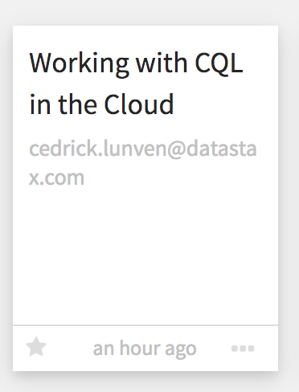
#1 – Working with CQL in the Cloud
Check that your Database is UP in Apollo
Open DataStax Studio
Navigate to « Working with CQL in the Cloud »
Play with the Notebook

Slide 48
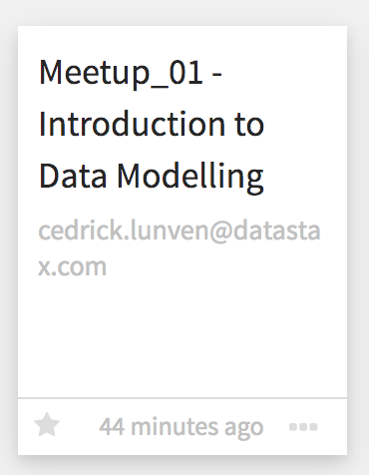
#2 – Introduction to Data Modelling
git clone https://github.com/clun/meetup_zero2Cloud.git
Locate the ”notebooks” the folder
Drag and drop « Meetup_01 - Introduction to Data Modelling » in the Studio
Execute the exercises in the Notebook

Slide 49
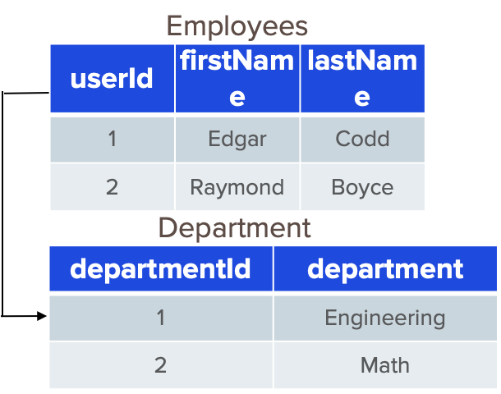

Relational Modeling
Data
Models
Application
Notes:
So in relational data modeling you start with your data, model the data according to normal forms and to increase data integrity and reduce data redundancy, and then determine application queries based off of the implemented data model

Slide 50
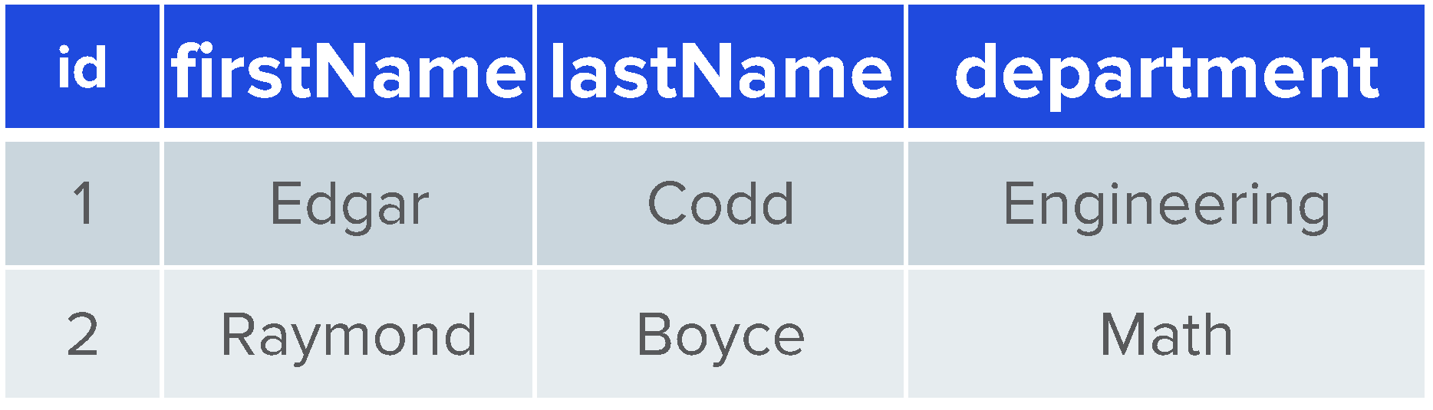
Cassandra Modeling
Application
Models
Data
Notes:
In Cassandra modeling this is completely flipped on its head. You start with application access patterns, use that to create a denormalized data model, then apply that model to your data.

Slide 51
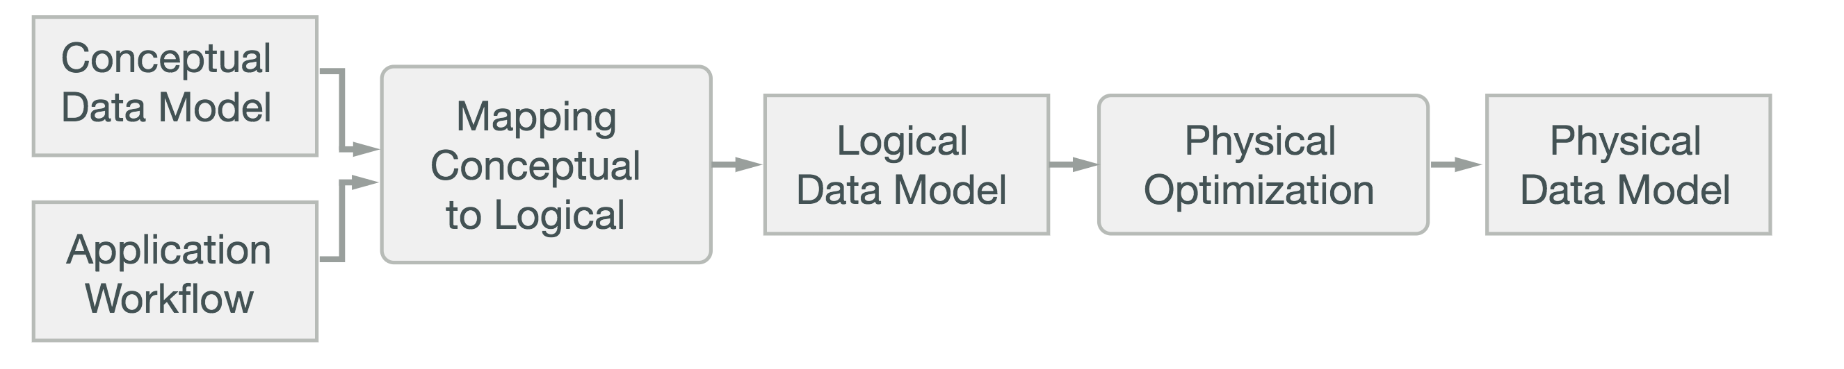
Designing Data Model
Entities & Relationships
Queries

Slide 52
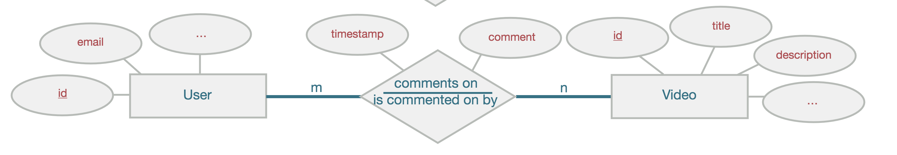
Conceptual Data Model

Slide 53
Application Workflow
R1: Find comments related to target video using its identifier
Get most recent first
Implement Paging
R2: Find comments related to target user using its identifier
Get most recent first
Implement Paging
R3: Implement CRUD operations

Slide 54
Mapping
Q1: Find comments for a video with a known id (show most recent first)
comments_by_video
Q2: Find comments posted for a user with a known id (show most recent first)
comments_by_user
Q3: CRUD Operations

Slide 55
Logical Data Model
comments_by_user
comments_by_video
userid
creationdate
commentid
videoid
comment
videoid
creationdate
commentid
userid
comment
K
K
↑
↑
C
C
C
↑
C
↑

Slide 56
Physical Data Model
comments_by_user
comments_by_video
userid
commentid
videoid
comment
videoid
commentid
userid
comment
UUID
K
UUID
K
C
↑
↑
TIMEUUID
TIMEUUID
C
UUID
UUID
TEXT
TEXT

Slide 57
Schema DDL
CREATE TABLE IF NOT EXISTS comments_by_user (
userid uuid,
commentid timeuuid,
videoid uuid,
comment text,
PRIMARY KEY ((userid), commentid)
) WITH CLUSTERING ORDER BY (commentid DESC);
CREATE TABLE IF NOT EXISTS comments_by_video (
videoid uuid,
commentid timeuuid,
userid uuid,
comment text,
PRIMARY KEY ((videoid), commentid)
) WITH CLUSTERING ORDER BY (commentid DESC);

Slide 58
“Designing Queries” Notebook
Time for an exercise!

Slide 59
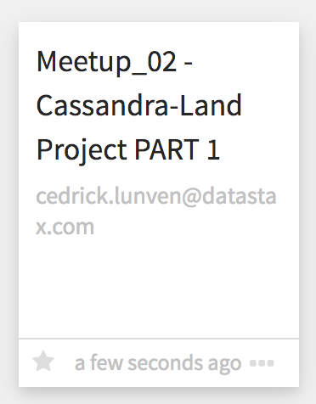
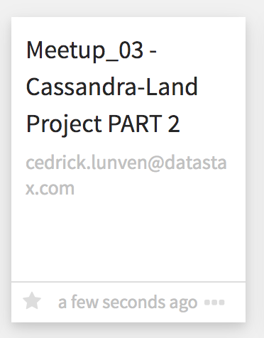
#3 – Cassandra Land
Drag and drop « Meetup_02 – Cassandra-Land PART 1 » in the Studio
Execute the exercises in the Notebook
Drag and drop « Meetup_03 – Cassandra-Land PART 3 » in the Studio
Execute the exercises in the Notebook

Slide 60
Agenda
0
Bootstraping
1
Understanding Apache Cassandra™ Use Cases
2
Data Modelling with Apache Cassandra™
3
Application Development
4
What’s NEXT ?

Slide 61
Application Development
Meetup @Stockholm

Slide 62








DataStax Drivers
DataStax Enterprise Drivers
OSS Drivers capabilities plus Enterprise improvements for
Performance, Usability, Scalability, Ecosystem
DSE Advanced Security, Unified Authentication
DSE Graph Fluent API
DSE Geometric Types
DataStax Cassandra Drivers (OSS)
CQL Support
Sync / Async API
Address Translation
Load Balancing Policies
Retry Policies
Reconnection Policies
- Connection Pooling
- Auto Node Discovery
- SSL
- Compression
- Query Builder
- Object Mapper
ODBC
JDBC

Slide 63


Apache
OSS Driver
DSE Driver
<dependency>
<groupId>com.datastax.oss</groupId>
<artifactId>java-driver-core</artifactId>
</dependency>
<<dependency>
<groupId>com.datastax.dse</groupId>
<artifactId>dse-java-driver-core</artifactId>
</dependency>

Slide 64
Connectivity
OSS Driver
DSE Driver
CqlSessionBuilder
DseSessionBuilder
Build
Build
CqlSession
DseSession
NB : “Cluster” concept from previous driver versions has been collapsed into “Session”

Slide 65

Builder
// Delegate all configuration to file or default
CqlSession cqlSession = CqlSession.builder().build();
// Explicit Settings
CqlSession cqlSession = CqlSession.builder()
.withCloudSecureConnectBundle(Paths.get(“/tmp/apollo.zip”))
.withKeyspace(“killrvideo”)
.withAuthCredentials(“myUser”, “myPassword”)
.build();
Notes:
TODO

Slide 66
How to to execute queries ?
First job of CqlSession is to execute queries using, well, execute method.
cqlSession.execute("SELECT * FROM killrvideo.users");
Statement

Slide 67
SimpleStatement
Statement statement = …
// (1) Explicit SimpleStatement Definition
SimpleStatement.newInstance("select * from t1 where c1 = 5");
// (2) Externalize Parameters (no name)
SimpleStatement.builder("select * from t1 where c1 = ?")
.addPositionalValue(5);
// (3) Externalize Parameters (name)
SimpleStatement.builder("select * from t1 where c1 = :myVal")
.addNamedValue("myVal”, 5);
cqlSession.execute(statement);

Slide 68
Prepared and Bound Statements
Compiled once on each node automatically as needed
Prepare each statement only once per application
Use one of the many bind variations to create a BoundStatement
PreparedStatement ps = cqlSession.prepare("SELECT * from t1 where c1 = ?");
BoundStatement bound = ps.bind(5);
cqlSession.execute(bound);

Slide 69

Query Builder

Slide 70
Query Builder
Fluent API for building CQL string queries programmatically
Contains methods to build SELECT, UPDATE, INSERT and DELETE statements
Generates a Statement as per the earlier techniques
OSS Driver (current version 4.2.0)
DSE Driver (current version 2.2.0)
<dependency>
<groupId>com.datastax.oss</groupId>
<artifactId>
java-driver-query-builder
</artifactId>
</dependency>
<<dependency>
<groupId>com.datastax.dse</groupId>
<artifactId>
dse-java-driver-query-builder
</artifactId>
</dependency>

Slide 71
Query Builder
import static com.datastax.oss.driver.api.querybuilder.QueryBuilder.bindMarker;
import static com.datastax.oss.driver.api.querybuilder.QueryBuilder.deleteFrom;
import static com.datastax.oss.driver.api.querybuilder.QueryBuilder.selectFrom;
import static com.datastax.oss.driver.api.querybuilder.relation.Relation.column;
// Simple SELECT using QueryBuilder
Statement stmtSelect = selectFrom(”killrvideo”, ”videos_by_users”)
.column(”userid”).column(”commentid”)
.function(”toTimestamp”, Selector.column(”commentid”)).as("comment_timestamp")
.where(column(”userid”).isEqualTo(bindMarker(”userid”)))
.build()
// Simple DELETE using QueryBuilder
Statement stmtDelete = deleteFrom(”killrvideo”, ”videos_by_users”)
.where(column(”userid”).isEqualTo(bindMarker(”userid”)))
.build()

Slide 72
Query Builder
Can also use QueryBuilder to create PreparedStatements and later execute at runtime
Note use of bindMarker() to designate parameters that will be provided later
// Prepared QueryBuilder statiements as any statement
PreparedStatement psStmt = cqlSession.prepare(
deleteFrom(”killrvideo”, ”videos_by_users”)
.where(column(”userid”).isEqualTo(bindMarker(”userid”)))
.build()));
// Binding
BoundStatement bsStmt = psStmt.bind(”e7a8ac9f-c12d-415c-a526-4137815df573”);
// Execute
cqlSession.execute(bsStmt);

Slide 73
ResultSet
ResultSet is the object returned for executing query. It contains ROWS (data) and EXECUTION INFO.
ResultSet is iterable and as such you can navigate from row to row.
Results are always paged for you (avoiding memory and response time issues)
ResultSet rs = cqlSession.execute(myStatement);
// Plumbery
ExecutionInfo info = rs.getExecutionInfo();
int executionTime = info.getQueryTrace().getDurationMicros();
// Data: NOT ALL DATA RETRIEVED IMMEDIATELY (only when needed .next())
Iterator<Row> iterRow = rs.iterator();
int itemsFirstCall = rs.getAvailableWithoutFetching();

Slide 74
Parsing ResultSet
// We know there is a single row (eg: count)
Row singleRow = resultSet.one();
// We know there are not so many results we can get all (fetch all pages)
List<Row> allRows = resultSet.all();
// Browse iterable
for(Row myRow : resultSet.iterator()) {
// .. Parsing rows
}
// Use Lambda
rs.forEach(row -> { row.getColumnDefinitions(); });
// Use for LWT
boolean isQueryExecuted = rs.wasApplied();

Slide 75
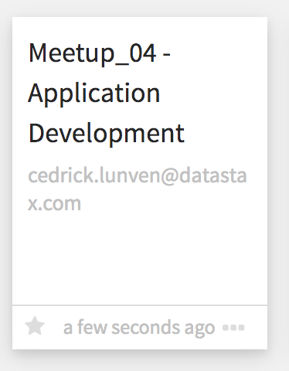
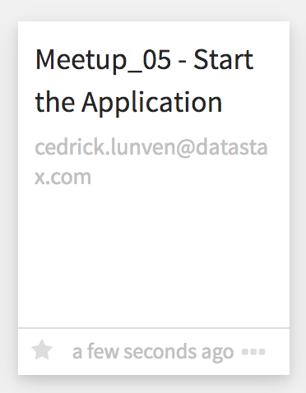
#4 – Application Development
Drag and drop « Meetup_04 – Application Development » in the Studio
Execute the exercises in the Notebook
Drag and drop « Meetup_05 – Start the Application» in the Studio
Execute the exercises in the Notebook

Slide 76
Agenda
0
Bootstraping
1
Understanding Apache Cassandra™ Use Cases
2
Data Modelling with Apache Cassandra™
3
Application Development
4
What’s NEXT ?

Slide 77
DataStax Academy
Developers and Architect Resources
Tell more about this section here
🏠 BACK TO AGENDA

Slide 78

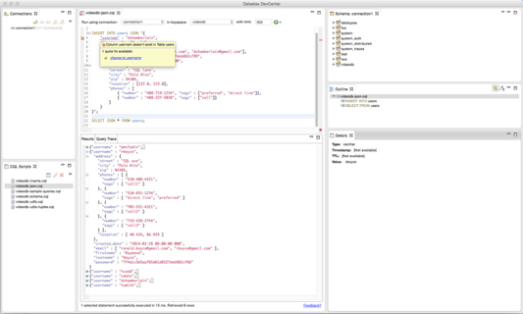
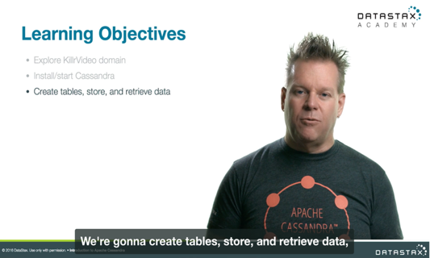
Training Courses at DataStax Academy
Free self-paced DSE 6 courses
DS201: DataStax Enterprise 6 Foundations of Apache Cassandra™
DS210: DataStax Enterprise 6 Operations with Apache Cassandra™
DS220: DataStax Enterprise 6 Practical Application Data Modeling with Apache Cassandra™
DS330: DataStax Enterprise 6 Graph
DS332: DataStax Enterprise 6 Graph Analytics (NEW)
https://academy.datastax.com

Slide 79
Learning Paths on DataStax Academy
Unsure where to start?
Follow a learning path to learn about topics related to your role.
Administrator
Analytics Specialist
Architect
Developer
Graph Specialist
Search Specialist
https://academy.datastax.com/paths

Slide 80
DataStax Community
Developers and Architect Resources
Tell more about this section here
🏠 BACK TO AGENDA

Slide 81

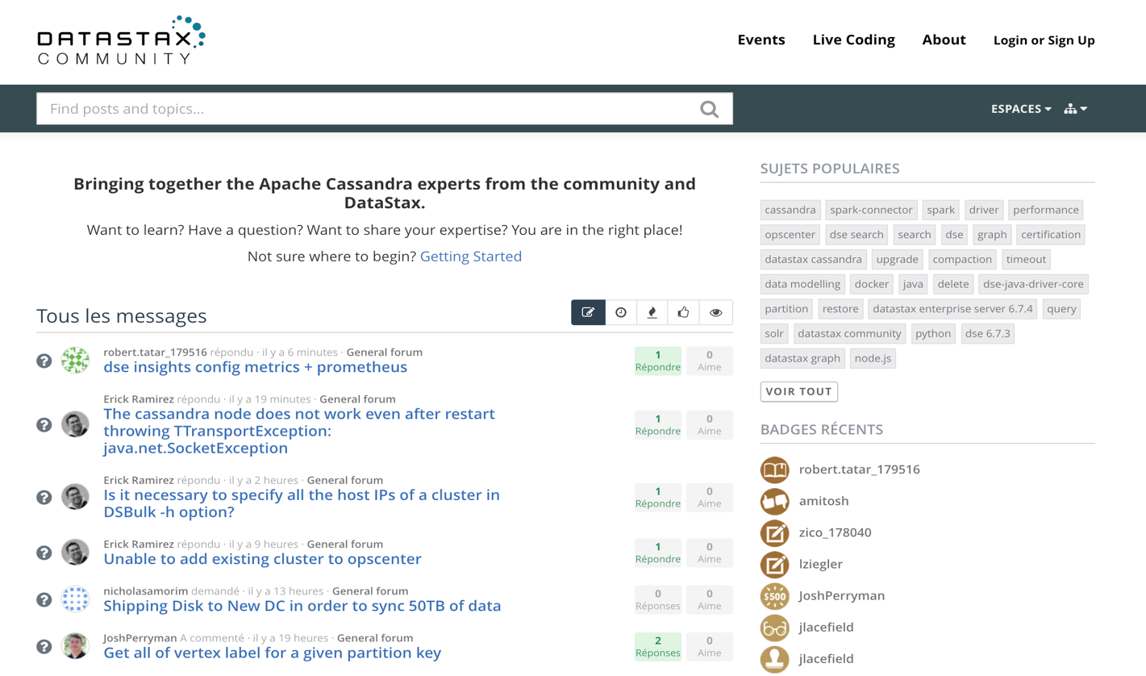
community.datastax.com

Slide 82
Sample Code and Reference Applications
Developers and Architect Resources
Tell more about this section here
🏠 BACK TO AGENDA

Slide 83
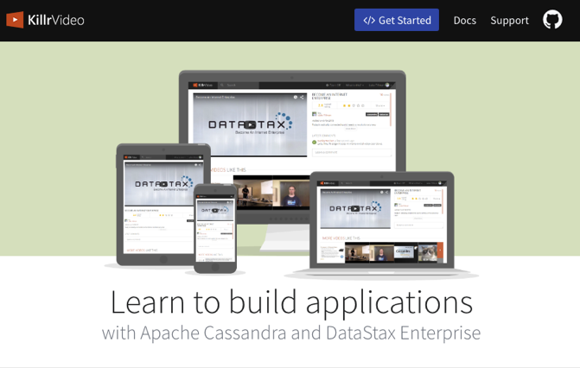

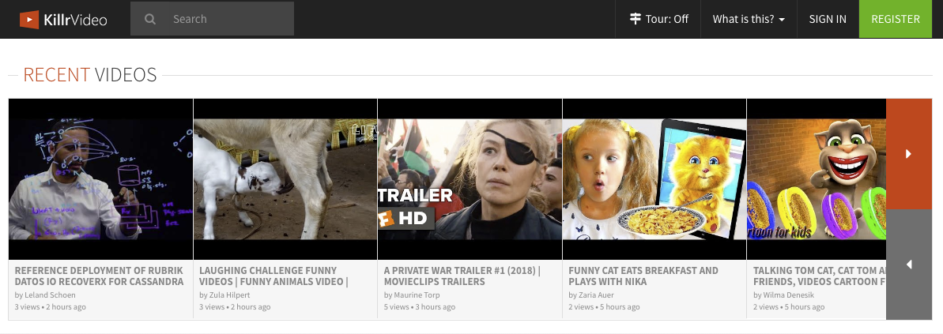
KillrVideo Reference Application
Reference application for learning how to use Apache Cassandra and DataStax Enterprise
DataStax Drivers
Docker images
Source code freely available
https://github.com/killrvideo
Live version
http://killrvideo.com
Download, test, modify, contribute!

Slide 84
Podcast, LiveStreams
Developers and Architect Resources
Tell more about this section here
🏠 BACK TO AGENDA

Slide 85
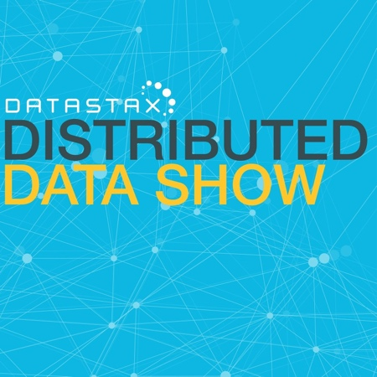
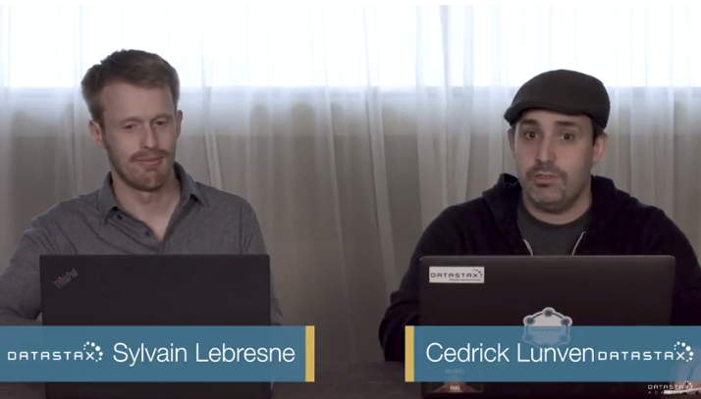
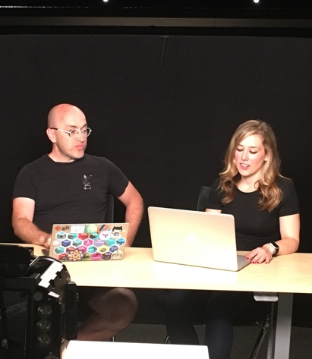

Distributed Data Show
Interview-style show featuring a mix of DataStax and industry guests
We go in-depth on the technology and challenges of data in large-scale distributed systems
Released weekly on DataStax Academy YouTube channel and as a podcast
Send us your suggestions for topics and guests – we love customer use cases

Slide 86

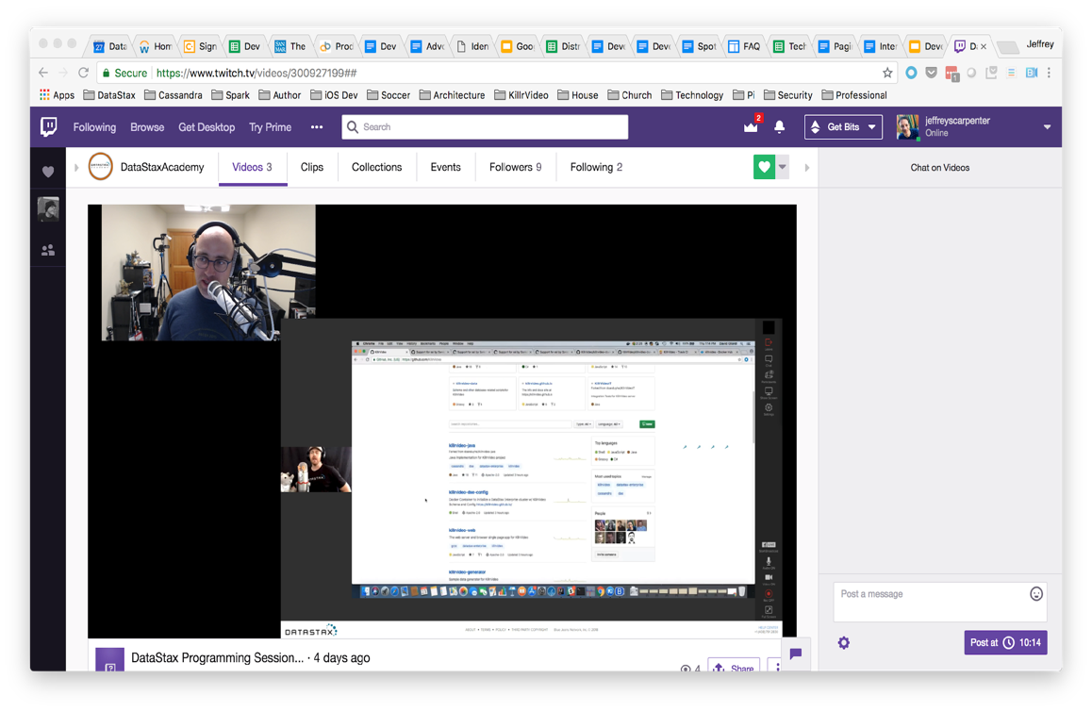
Live Coding on Twitch
Live coding sessions with advocates and guests each Thursday
https://www.twitch.tv/datastaxacademy
Working through the challenges of building distributed systems
Join the conversation and ask questions
Some advocates also do streaming on personal channels

Slide 87


